Slide 1
Application of
Jean Watson’s
Theory of Human Caring

Slide 2
Presented by:
Group One
Ferris State University
Mary Bierlein
Anita Riddle
Deanna Warnock
Holley West
Carolyn Zielinski

Slide 3
Theory of Human Caring
Ten Carative Factors
Ten Caritas Processes
Give of self, Instill Faith and Hope, Sensitivity, Authenticity, Expression of Feelings, Satisfaction of Needs first, Healing Environment, allowing for the Unknown
Caring moments: If transpersonal connection is spiritual.
Spend time with your patients, get to know who they are, not just their disease or illness.
Treat patient holistically (Mind, Body, Spirit)
First book, Nursing: The Philosophy and Science of Caring was written in 1979. Second book, Nursing: Human Science and Human Care- A Theory of Nursing, was published in 1985 and reprinted in 1988 and 1999.
(Alligood, 2010)
“Transpersonal caring relationships are the foundation of the work” (Watson, 2010)

Slide 4
Why Apply Watson’s Theory?
Carative factors represent nursing from other professions.
Basic assumptions and carative factors construct the structure of this unique theory.
Can be applied following the nursing process.
Focus is placed on spiritual, emotional, nurse-patient relationship that meets the higher level of human needs.
Can be used to direct and enhance practice.
Promotes holistic care.
Patient is seen as apart of a family, community, and culture specific to them as a holistic human being.
Distinguishes patient as focus of “practice rather than the technology”.
(“Jean Watson’s Philosophy”, 2010).

Slide 5
Rationale for Use of Jean Watson’s Theory of Human Caring
Strengthen the transpersonal caring relationship between nurse and patient
Improving on the caring life moments that take place between nurse and patient
To provide a “moral/ethical foundation for professional nursing” (Watson, 2011, para. 1)
Integrate art and science into practice

Slide 6
Watson’s Theory Explored
The Theory of Caring has been researched and applied in many areas including:
Hospice and Palliative Care
Rehabilitation
Emergency Care
Geriatrics
Long Term Care
Specialty Settings
Team Building
Stress Management

Slide 7
Application of Jean Watson’s Theory in Hospice and Palliative Care

Slide 8
Perceptions of the most helpful nursing behaviors in home-care hospice setting: Caregivers and nurses (Ryan, 1992)

Slide 9
Purpose of Study
The Theory of Human Caring states the practice of caring is essential and the foremost important part of nursing and the purpose of nursing is to enhance a person’s sense of well-being by assisting in attainment of harmony among the mind, body, and spirit. This study was intended to determine the validity of Watson’s theory of caring nursing behaviors as perceived by patient’s and benefits or disadvantages of such behaviors (Ryan, 1992, p. 23).

Slide 10
Assumptions
“Caring is central to nursing
Care enhances patients’ quality of life
Hospice nursing involves caring” (Ryan, 1992, p. 23).

Slide 11
Structure of Study
Five Hospice Nurses
Twenty Primary Caregivers of Home-Care Hospice Clients
Watson’s theory provided framework for this study to convey the importance of nursing behaviors as they are perceived by client and caregivers during end-of-life. This realization can “promote caring and quality of life for terminally-ill patients and their caregivers” (Ryan, 1992, p. 23)

Slide 12
Structure Continued
“Q-sort of 60 nursing behaviors ranked from most to least helpful was completed (…) during the bereavement period” (Ryan, 1992, p. 22).
Criteria for caregivers included death of hospice patient occurring within last two to six months.
Caregivers and nurses were chosen randomly using a table of identification numbers.

Slide 13
Data Collection
“In a Q-sort, the subject is presented with a set of cards on which words, phrases, statements, or other messages are written. The subject is then asked to sort cards according to particular dimension” (Ryan, 1992, p. 24).
Sixty nursing behaviors divided into three behavior tiers related to: Patient physical needs, patient psychosocial needs, and caregiver psychosocial needs (Ryan, 1992, p. 25).
Score of one through seven given with one being least helpful and seven being most helpful (Ryan, 1992, p. 25).

Slide 14
Procedure
Institutional Review Board for the Protection of Human Subjects and the Hospice agency granted permission for study conduction (Ryan, 1992, p. 25)
“ Caregivers completed demographic data and indicated the amount of pain experienced by the hospice patient prior to completing Q-sort” (Ryan, 1992, p. 25).

Slide 15
Findings: Caregiver Perceptions of Ten Most Helpful Nursing Behaviors: Most to Least
Category | Nursing Behavior
Patient’s psychosocial needs | Listen to the patient/Listen to what the patient wants
Patient’s physical needs | Provide patient with the necessary emergency measures if the need arises
Caregiver’s psychosocial needs | Assure me that the nursing services will be available 24 hours a day, 7 days a week
Patient’s psychosocial needs | Answer the patient’s questions honestly
Patient’s psychosocial needs | Talk to the patient to reduce his/her fears
Caregiver’s psychosocial needs | Provide me with information necessary if a home death occurs
Caregiver’s psychosocial needs | Answer my questions honestly, openly and willingly
Patient’s psychosocial needs | Stay with patient during difficult times
Patient’s psychosocial needs | Assure the patient that nursing services are available 24 hours a day, 7 days a week
Patient’s physical needs | Teach me how to keep the patient physically comfortable
(Ryan, 1992, p. 25)

Slide 16
Findings: Caregiver Perceptions of Ten Least Helpful Nursing Behaviors: Least to Most
Category | Nursing Behavior
Caregiver’s psychosocial needs | Talk to me about my guilt
Caregiver’s psychosocial needs | Cry with me
Caregiver’s psychosocial needs | Help me make funeral arrangements
Caregiver’s psychosocial needs | Assist me in establishing a method for recording medications
Patient’s physical needs | Attend the funeral and/or go to the funeral home when the patient dies
Patient’s physical needs | Teach me how to turn and position the patient
Patient’s physical needs | Assist me in learning how to change the bed sheets with the patient in bed
Caregiver’s psychosocial needs | Recognize my need to talk about things unrelated to death
Caregiver’s psychosocial needs | Help me to face reality in my own way in my own time
Caregiver’s psychosocial needs | Assure me that the patient can be readmitted to the hospital if necessary
(Ryan, 1992, p. 26)

Slide 17
Findings: Hospice Nurses’ Perceptions of Ten Most Helpful Nursing Behaviors: Most to Least
Category | Nursing Behavior
Caregiver’s psychosocial needs | Assure caregiver that the nursing services will be available 24 hours a day, 7 days a week
Patient’s physical needs | Teach the caregiver how to keep patient physically comfortable
Patient’s psychosocial needs | Help the patient to feel safe ventilating anger, sadness, anxiety and other feelings
Patient’s psychosocial needs | Answer the patient’s questions honestly
Patient’s psychosocial needs | Listen to the patient/ Listen to what the patient wants
Patient’s psychosocial needs | Assure the patient that nursing services are available 24 hours a day, 7 days a week
Patient’s physical needs | Teach the caregiver how to relieve the patient’s symptoms
Caregiver’s psychosocial needs | Provide the caregiver with the information necessary if a home death occurs
Caregiver’s psychosocial needs | Help the caregiver to feel safe ventilating anger, sadness, anxiety and other feelings
Patient’s psychosocial needs | Recognize when the patient needs to talk about death and dying
(Ryan, 1992, p. 27)

Slide 18
Findings: Hospice Nurses’ Perceptions of Ten Least Helpful Nursing Behaviors: Least to Most
Category | Nursing Behavior
Patient’s physical needs | Describe how to keep the patient well groomed
Patient’s physical needs | Assist the caregiver to provide a clean, neat, environment for the patient
Patient’s physical needs | Do not encourage the patient to have false hope
Caregiver’s psychosocial needs | Cry with the caregiver
Caregiver’s psychosocial needs | Pray with the caregiver
Patient’s physical needs | Teach the caregiver to prevent long term complications of bed rest
Patient’s physical needs | Teach the caregiver how to adjust the diet as needed
Caregiver’s psychosocial needs | Teach the caregiver how to adjust the diet as needed
Caregiver’s psychosocial needs | Help the caregiver feel safe ventilating anger, sadness, anxiety and other feelings
Patient’s psychosocial needs | Encourage the patient to hope
Patient’s physical needs | Teach the caregiver how to give some of the care to the patient
(Ryan, 1992, p. 27)

Slide 19
Evaluation of Study
Limitations:
  Study group represents small demographic area
  Broad scope of Q-sort material within small group narrows results of data
  Does not include pertinent data in relation to where death occurred, type of hospice program, certification of program, and length of care
  These can be remedied by broadening the study group to include more caregivers and nurses and including other pertinent data.

Slide 20
Application of Research
This study concludes that psychosocial needs are more important than physical needs to both the nurse and the patient
Giving patient and caregiver a survey of nursing behaviors to assess their personal needs may assist the nurse in focusing care according to individualized need
Holistic care in the hospice setting necessitates incorporation of caregiver needs along with patient needs

Slide 21
Reflection
Nursing research into the application of the Theory of Caring in relation to end-of-life care needs to be expanded and updated.
Spiritual aspects of humanity are realized through the grieving process and nurses need to be comfortable and open-minded with such topics.
Caritas nursing applies to hospice care by encouraging expression of all feelings, faith and hope, and unexplained phenomena

Slide 22
“Involvement of Relatives In the care of the dying in different care cultures: development of a theoretical understanding (Andershed and ternestedt, 1999).
Jean Watson’s Theory of Caring

Slide 23
The participants
6 spouses and their dying loved ones
Life expectancies of 2 weeks-9 months
1 woman and 5 men
Ages 46-84

Slide 24
Purpose
The purpose of this study “was to identify and categorize relatives’ in the care of a dying family member in different care cultures and to develop a theoretical understanding of the involvement (Andershed and Ternestedt, 1999, p. 46).
An additional aim of this study was to “determine and discuss the congruence and incongruence between the empirical results and key concepts in Watson’s theory of caring” (Andershed and Ternestedt, 1999, p. 46).

Slide 25
Patterns
Throughout the study similarities were compiled that compared for each individual and between individuals. Patterns were found in regards to the actions and reactions of the individuals. Three patterns or categories were found to define the behavior of the family members with the patients. They are as follows “to know, to be, to do” (Andershed and Ternestedt, 1999, p. 46).

Slide 26
TO KNOW
Refers to those participants that strove to increase their increase their knowledge and their understanding of their loved ones’ condition and prognosis. They wanted to know what staff was doing for their loved one and what they were going to do as the patient’s condition deteriorated.
Not actually stated as one of Watson’s 10 carative factors, maybe due to the fact that Watson assumes that knowing and understanding the patient’s life-world is necessary for humanistic care.

Slide 27
TO BE
Referred to the spouses wanting to not only be with their loved ones but be in their loved one’s world wherever that may be. They were “involved at a deeper level in the patient’s world” (Andershed and Ternestedt, 1999, p. 48).
This finding is very much related to Watson’s caring theory, wherein transpersonal caring relationships are thought to concern “authenticity of being and becoming, and ability to be present” (Watson, 1987, p. 51).
This view is reflected in all 10 of Watson’s carative factors.

Slide 28
TO BE (continued)
To be involved, to being present, to being in their loved one’s world-there was an intimacy that was present that had not been present before.
In Watson’s “transpersonal caring theory of nursing, the first carative factor is forming and acting from a humanistic-altruistic system of values” (Andershed and Ternestedt, 1999, p. 50.).

Slide 29
TO DO
“To Do” indicates the many practical things that relatives did in caring for their family member. Involves doing what the patient would do if he/she were able.
To Do is consistent with Watson’s ninth carative factor, which concerns assisting persons to meet basic needs while preserving their dignity and wholeness.

Slide 30
CONCULSION
It was concluded that
  For nurses to be able to guide relatives on the patient’s final journey, it is a prerequisite that the nurse knows what the family/patient wants and can do. A collaboration among these three actors is of the greatest importance if the family is to be involved in the light and support the patient in attaining a dignified death in an often short period of time. Further study is needed in this area (Andershed and Ternestedt, 1999, p. 51).

Slide 31
Jean Watson’s Caritas Theory
As Developed by Patty Magee, RN, BS, MA

Slide 32
Caritas Theory
“Connecting Art and Wellness” at Baptist Medical Center South, Jacksonville, FL
Focus: art is healing for everyone.
Rationale: “Caritas Journey for all Nurse's is to explore every avenue in making patient's comfortable” (http://pattymageeart.blogspot.com, 2009).
Using art to deal with stress for patients and staff
Unlimited forms of art

Slide 33

Research approach and findings in “The Caring Arts Program”
Example: Carative Factor 6
Systematic use of scientific (creative) problem solving caring process.
Employees met for creative role play using painting on canvas.
Photo courtesy of patty magee, nurse artist at http://pattymageeart.blogspot.com/

Slide 34
Limitations/credibility – the Caring Art PRogram
No formal evaluation of program
It tends to appeal to “artistic” personalities
Has only been tested since 2009 (18 months)
The program has received many community awards

Slide 35
Implications for practice
Applicable caritas’ to patients and staff members
Make hospitalization less “institutional” (by displaying art on walls and at bedside, involvement in art as a medium).
Allow for multiple artistic venues for creativity
Outlet for stress (patients, families, and staff).

Slide 36
Critical reflection
Using nursing theory can add depth to nursing practice in areas not formally researched.
Furthering research on the mind-body connection.
Offers a way to explore “non-traditional” nursing.

Slide 37
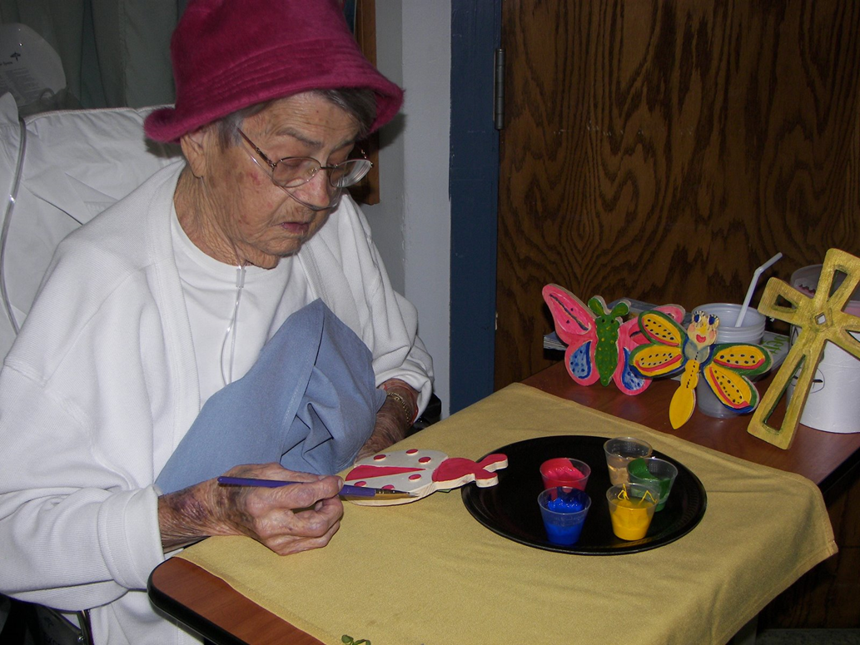
Connecting art and wellness
Photo courtesy of patty magee, nurse artist at http://pattymageeart.blogspot.com/

Slide 38

Rediscovering the Art of Healing Connection by Creating the Tree of Life Poster
Teri Britt Pipe, PhD, RN
Kenneth Mishark, MD
Reverend Patrick Hansen, MA, PCC
Joseph G. Hentz, MS
Zachary Hartsell, PA-C
bravecreatures.com

Slide 39

The Study
The goal of this study was to help nurses build meaningful therapeutic relationships with their patients
Patients sometimes feel “disconnected from nurses” (Pipe, Mishark, Hansen, Hentz & Hartsell, 2010, p. 48) due to the highly technical nature of healthcare
“Research suggests a link between how well providers know patients and how likely they are to detect and act on negative changes in patient health status” (Pipe et al., 2010, p.48)

Slide 40
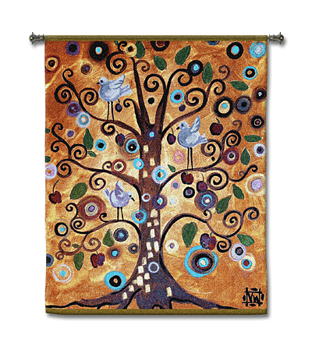
The Life-story Intervention
Posters were created and displayed in the patients room that “highlighted important life events and personal perspective that patients wanted to share”(Pipe et al., 2010, p. 48).
Low-tech way of improving therapeutic relationship between patient and nurse focusing on hospitalized elderly adults.
Staff were able to read the information on these posters and then engage in meaningful conversation with a patient rather than talking about superficial things such as the weather.
http://www.medievalwalltapestry.com/untitled-from-the-tree-of-life.html

Slide 41
Participants
Open to any patient that was admitted to a general medical floor of the academic hospital during the 8 month time frame
Must be 18 years of age or older and “able to respond to the interview questions” (Pipe et al., 2010, p. 51). Mean age of participants was 73.8.
Patients were not within normal limits on a cognitive screen, unable to respond to interview questions, too ill or did not consent were not included in study
A total of 19 patient participated all with a variety of conditions and comorbidities
Census was updated daily for possible candidates

Slide 42

Method of Measurement
Questionnaire asking patients how they would describe their overall:
  Quality of life
  Mental wellbeing
  Physical wellbeing
  Emotional wellbeing
  Social activity
  Spiritual wellbeing
Scale form 1-10 (1 being as bad as it can be, 10 being as good as it can be)
Questionnaire asked prior to life poster being made and again at discharge. A question asking patients if the tree of life poster improved their overall quality of life was asked at discharge as well

Slide 43
Results
“Of the 19 patients enrolled, 15 provided data at discharge; the remaining patients were not available for interview at discharge either because they left the hospital or they were transferred to a higher level of care” (Pipe et al., 2010, p. 52)
67% of patient agreed that their quality of life had improved after participating in the study
Physical and emotional wellbeing had the highest increase of the individual topics after study
Communication improved not only between nurse and patient but also between other staff, family and patient

Slide 44
Framework
“Watson’s Theory Human Caring guided the study and the interpretation of the findings” (Pipe et al., 2010, p. 49).
Study focused on building a caring relationship with patients
The poster helped provide a healing environment and “provided extended opportunities for caring-healing moments” (Pipe et al., 2010, p. 49).
Focused on building the transpersonal healing relationship between nurse and patient

Slide 45
Limitations
Small sample
20% of patients did not provide outcome
Hospital setting not as ideal as other setting due to short length of stay
Results could possibly be biased because data was only collected from patients who willingly participate
Quality of life could have been improved for other reasons than Tree of life poster, such as improvement of health and recovery process

Slide 46
Implications for Practice
Tree of Life poster can be used in multiple settings such as long term care and specialty settings
Improvement of meaningful communication
Tree of Life poster does not have to be made to improve nurse to patient relationship, nurse can engage in meaningful conversation by asking patients about past life experiences or family
This model can be used on any population. All patients have a life story

Slide 47

Critical Reflection
Integrating research into nursing practice is vital to evidence based practice nursing. In regards to the Tree of Life poster study, research showed that hospitalized older adults quality of life can be improved by using Watson’s Theory of Caring to improve caring communication and build a therapeutic nurse patient relationship. Watson’s theory puts emphasis on creating caring moments with patients.

Slide 48
“THE IMPORTANCE OF NURSE CARING BEHAVIORS AS PERCEIVED BY PATIENTS RECEIVING CARE AT AN EMERGENCY DEPARTMENT”
BASED ON THE CARATIVE FACTORS OF JEAN WATSON
GYDA BALDURSDOTTIS, MS, RN & HELGA JONDOTTIR, PHD, RN

Slide 49
Background
Study takes place in the Emergency Department (ED) at University Hospital in Reykjavik, Iceland
Complaints from patients of staff’s poor attitudes
Rising patient admissions
Longer stays in the ED
Increased demand for cost-effective hospital management
Shortage of nurses
“It is therefore, of the utmost importance to know how Icelandic people perceive hospital nursing care and to compare these results with previous studies on the subject, because nursing care is the single most significant factor in the patient’s perception of high-quality hospital care”

Slide 50
purpose
Identify nursing behaviors that are perceived to be caring
Categorize the behaviors in the order of importance to an ED patient
The questions to be answered are:
“Which nurse caring behaviors are perceived as most important and least important by patients in the ED?”
“Do patients’ perceptions of nursing care behaviors differ according to demographic factors, that is age, residence (capital city vs outside the capital city area), educational level, gender, and perception of illness?”

Slide 51
Definition of caring
The definition of caring for the purpose of this study is taken from Cronin & Harrison, based on Jean Watson’s framework of caring.
“Caring is the process by which the nurse becomes responsive to another person as a unique individual, perceives the other’s feelings, and sets that person apart from the ordinary” (Cronin, & Harrison, 1998).

Slide 52
methodology
Non-experimental
Quantitative
The Caring Behavior Assessment Tool (CBA) was used, which was developed by Cronin and Harrison.
Population: adult patients who were patients at the University Hospital, who were discharged without admission
The CBA was mailed in the form of a 61 item questionnaire to each patient
Gender, residence, age, education and demographics were included
Study was over a one month census, 300 patients met the above criteria
Response rate was 60.7% (n=182)

Slide 53
Studies using the caring behaviors tool

Slide 54
Assumptions
1. “Basic components of nursing care provided
in the ED where the study took place are the
same for each patient, regardless of which
nurse provides the care.”
2. “Potential participants are able to identify the
professional status of the nurses as distinct
from both licensed practical nurses and
nursing students.”

Slide 55
Analyzing the data
Mean scores and standard deviations were calculated using each of the 61 questions
The 10 most important and the 10 least important caring behaviors were identified
These results were divided into 7 subscales (see tables II-III)
A mean for each subscale was calculated (rating of 1-5 with 5 most important)

Slide 56
10 most important nurse caring behaviors

Slide 57
10 least important nurse caring behaviors

Slide 58
limitations
Study was done in one ED in one hospital
Seriously ill patients were admitted and not included in the study
Study cannot be generalized to all ED populations
“Participation is also limited to persons who can read and write the Icelandic language and are 18 years of age or older, thus excluding a considerable portion of the patients (ie, children and their parents).”

Slide 59
conclusions
Most important nurse caring behavior is “Know what they are doing”
“The older the subjects, the more important were the nurse caring behaviors”
“Female participants scored significantly higher than males in 5 of 7 subscales, which accords with the notion that females have a better conception of caring than males”
No significant differences were identified related to place of residence
No significant differences were identified related to perception of the seriousness of the patient’s illness (ie, urgent and non-emergent both had high expectations for the nurse’s caring behavior)
The lower the education of the patient ,the higher the importance of caring

Slide 60

Findings as they relate to jean Watson's theory of caring
http://www.watsoncaringscience.org/
“These results support Watson’s notion of caring as being manifested in actions for and on behalf of patients, in which the result is enrichment and protection of human dignity”
“A caring moment can be created when the nurse is morally conscious and authentically present with the patients in fulfilling their unmet needs”

Slide 61
Nurse caring behaviors
A Parting Thought
“Caring is therefore not something the nurse reveals after finishing basic nursing care; rather in quality nursing practice, caring and competence necessarily coexist”

Slide 62
References
Alligood, M. R., Tomey, A. M.(2010). Nursing theorists and their work (7th ed.). St. Louis, MO: Mosby Elsevier.
Anderson, B. & Ternestedt, B. M. (1999). Involvement of relatives in care of the dying in different care cultures: Development of a theoretical understanding; Nursing Science Quarterly, pp. 45-51, doi:1177/08943189922106404.
Baldursdottir, G., & Jonsdottir, H. (2002). The importance of nurse caring behaviors as perceived by patients receiving care at an emergency department. Heart & Lung, 31(1), 67-74.
  “Connecting Art and Wellness”.(2010), Retrieved from http://pattymageeart.blogspot.com
Cronin, S., & Harrison B. (1988). Importance of nursing caring behaviors as perceived by patients after myocardial infarction. Heart & Lung, 17, 374-380.
Jean Watson’s philosophy of nursing (2010, June 27). Retrieved from http://currentnursing.com/nursing_theory/Watson.html
  Overview of Jean Watson's Theory (n.d.). In VanguardHealth Systems. Retrieved February 5, 2011, from http://www.innovativecaremodels.com/uploads/File/caring%20model/Overview%20JW%20Theory.pdf
  Pipe, T.B., Mishark, K., Hansen, P., Hentz, J.G., &Hartsell, Z. (2010). Rediscovering the art of healing connection by creating the tree of life poster. Journal of Gerontological Nursing, 36(6), 47-55.

Slide 63
References
Ryan, P. (1992, September/October). Perceptions of the most helpful nursing behaviors in a home-care hospice setting: Caregivers and nurses. American Journal of Hospice & Palliative Care, 9(22), 22-31. doi:10.1177/104990919200900512
Watson, J. (1985). Nursing: The philosophy and science of caring. Boulder, CO. Associated University Press.
Watson, J. (1988). Nursing: Human science and human care. A theory of nursing. Boulder, CO. Associated University Press.
Watson, J. (1989). Watson’s philosophy and theory of human caring in nursing. In J.P. Riehl-Sisca (Ed.), Conceptual models for nursing practice. Norwalk, CT: Appleton and Lange.
Watson, J. (1997). The theory of human caring: Retrospective and prospective. Nursing Science Quarterly, 10, 49-52.
  Watson, J. (2010). Caring Science Ten Caritas Processes. In Watson Caring Science Institute. Retrieved January 31, 2011, from http://www.watsoncaringscience.org/ j_watson/theory.html
Watson, J. (2010). Watson Caring Science Institute. Retrieved from http://www.watsoncaringscience.org
Watson, J. (2011). The caring science institute. The implication of caring theory. Retrieved from http://www.watsoncaringscience.org/

